Slide 1
Energy and Explosions

Slide 2
The Fourth State of Matter

Slide 3
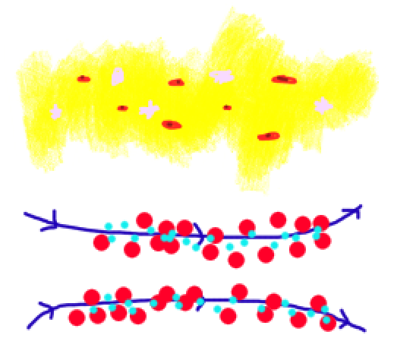
Plasmas
No fixed shape or volume and has free charges (Debye length)
Characterized by temperature, density, and ion charge
Termed by Langmuir in 1929 due to similarities to blood plasma

Slide 4
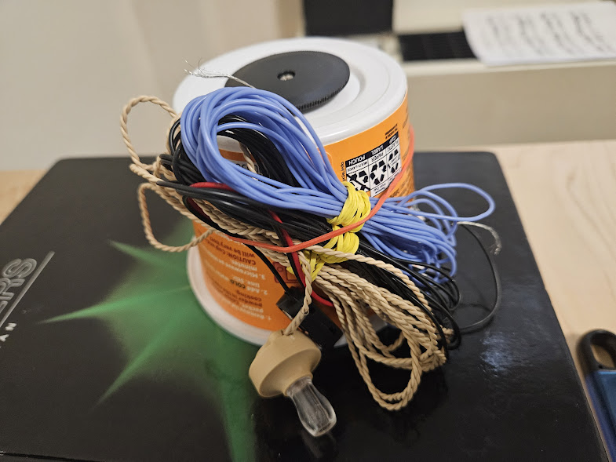
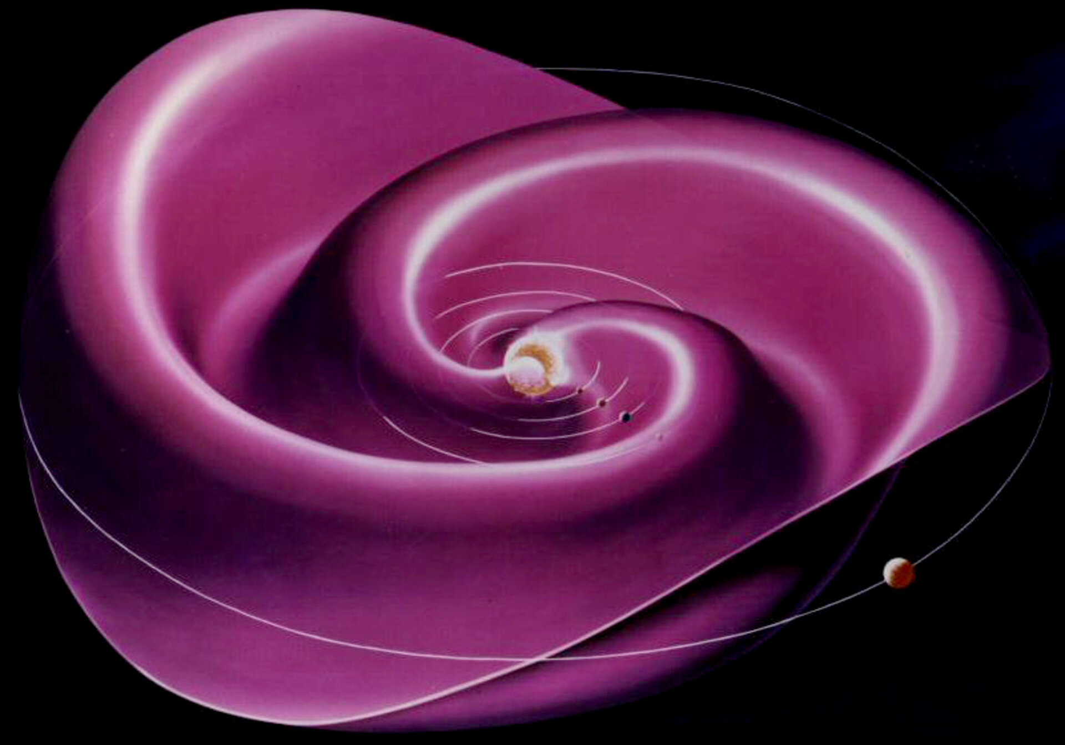
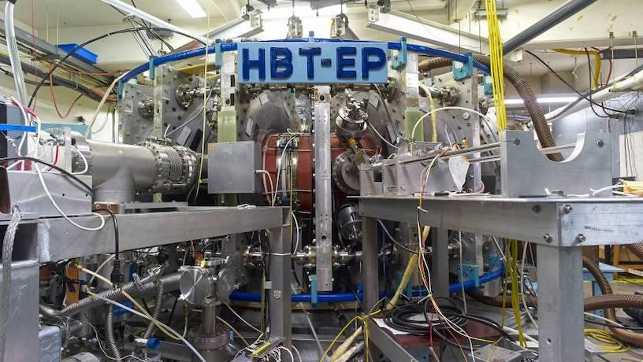
Applications
Radios
Astronomy
Fusion
Semiconductors

Slide 5
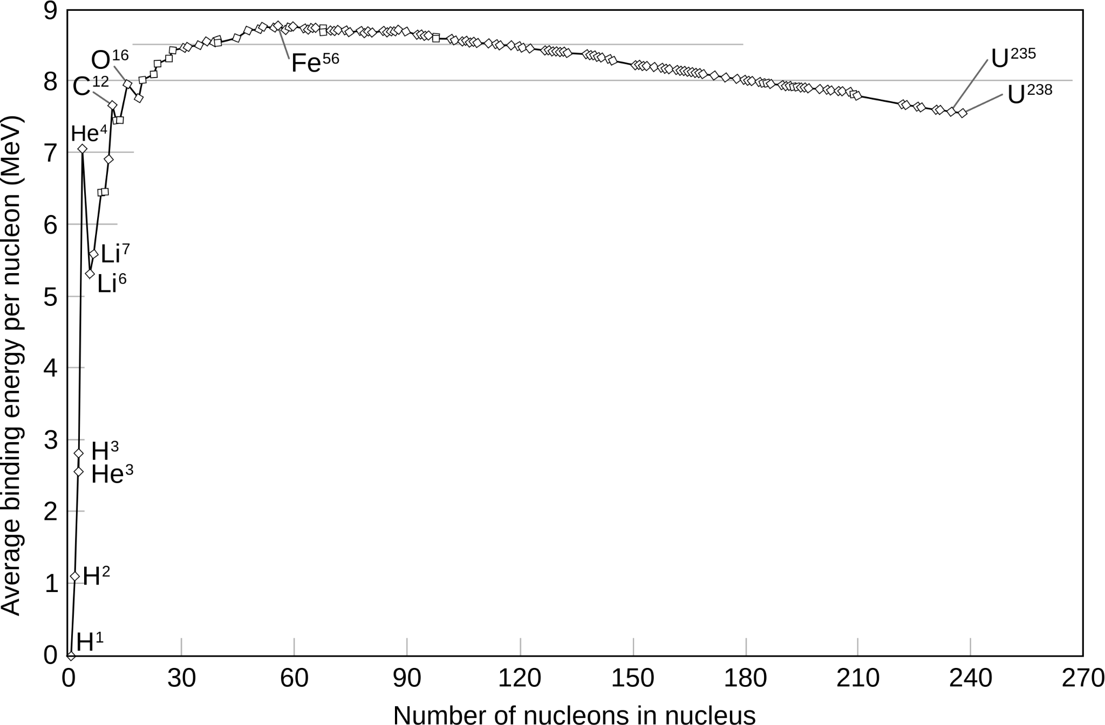
Fusion
Method to harvest mass energy
Unusually high binding energy for helium-4: good fusion product
Often deuterium and tritium used as fuel as they have the lowest nuclear charge

Slide 6
Fueling up for Fusion

Slide 7
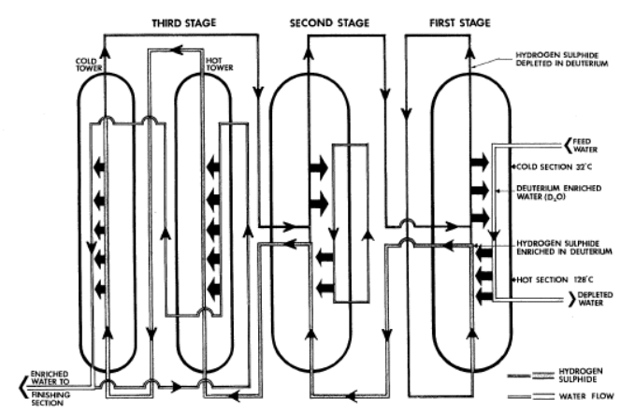

Deuterium
1) Naturally occurring in ocean water (1/6400 atoms are deuterium)
3) Electrolysis to extract the deuterium gas
2) Refinement using the GS process and distillation can get 99% heavy water concentration (D2O)

Slide 8
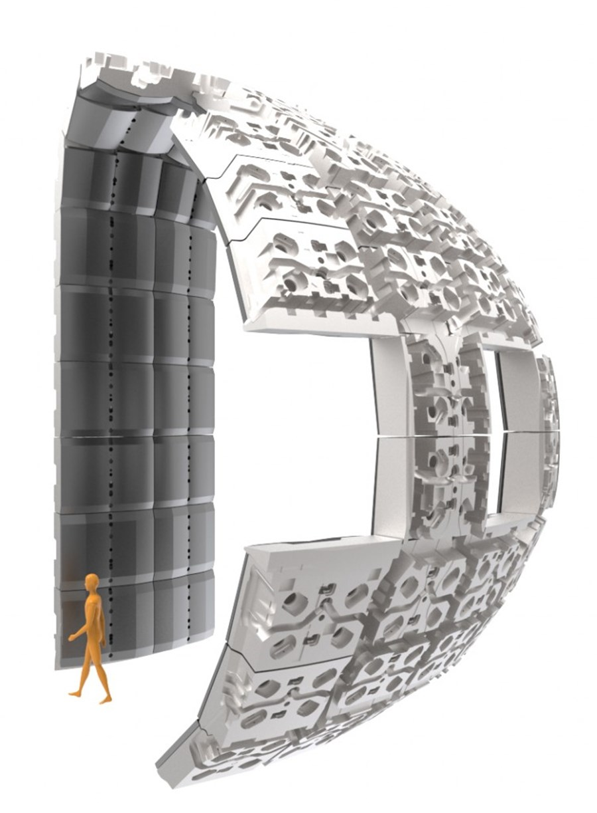
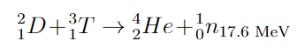
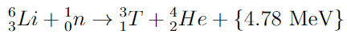

Tritium
Hard to find naturally
Generally bread at nuclear reactors or during continuous fusion

Slide 9
Harnessing the Power of the Sun

Slide 10
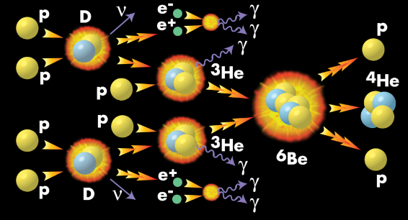
Inertial Confinement
Quick confinement of mass creates high-temperature and high-pressure environments
Simulate the extreme fusion environments in the sun

Slide 11
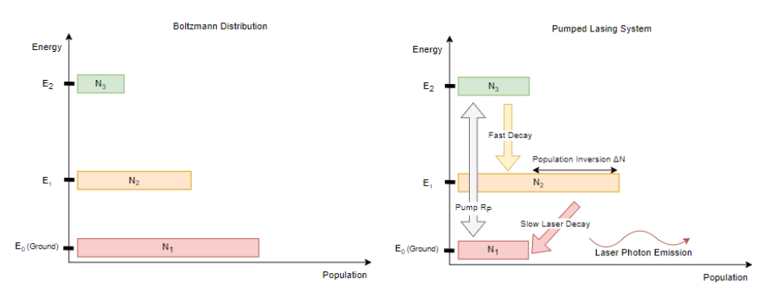
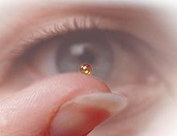
Lasers
Developments in ultrashort pulse lasers (including the 2023 Nobel Prize) led to their adoption in inertial confinement fusion

Slide 12
The Energy of the Future

Slide 13
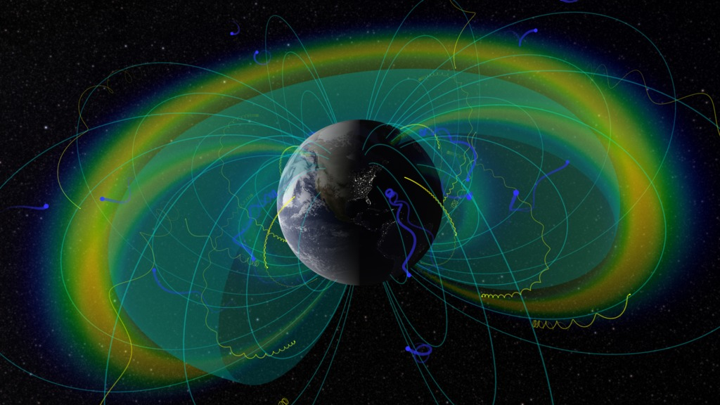
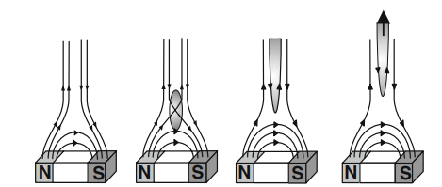
Magnetic Confinement
Fuel is heated to become plasma
Charged particles take helical paths around magnetic fields

Slide 14
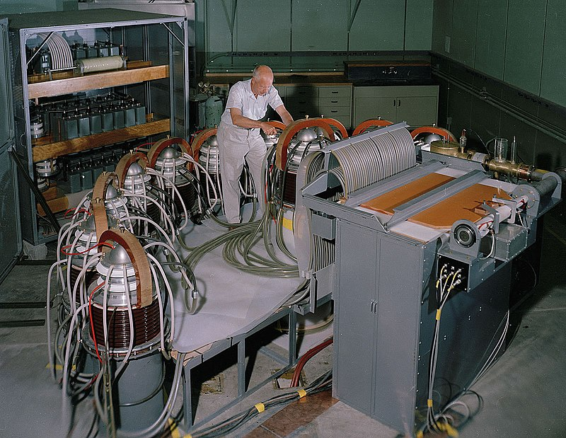
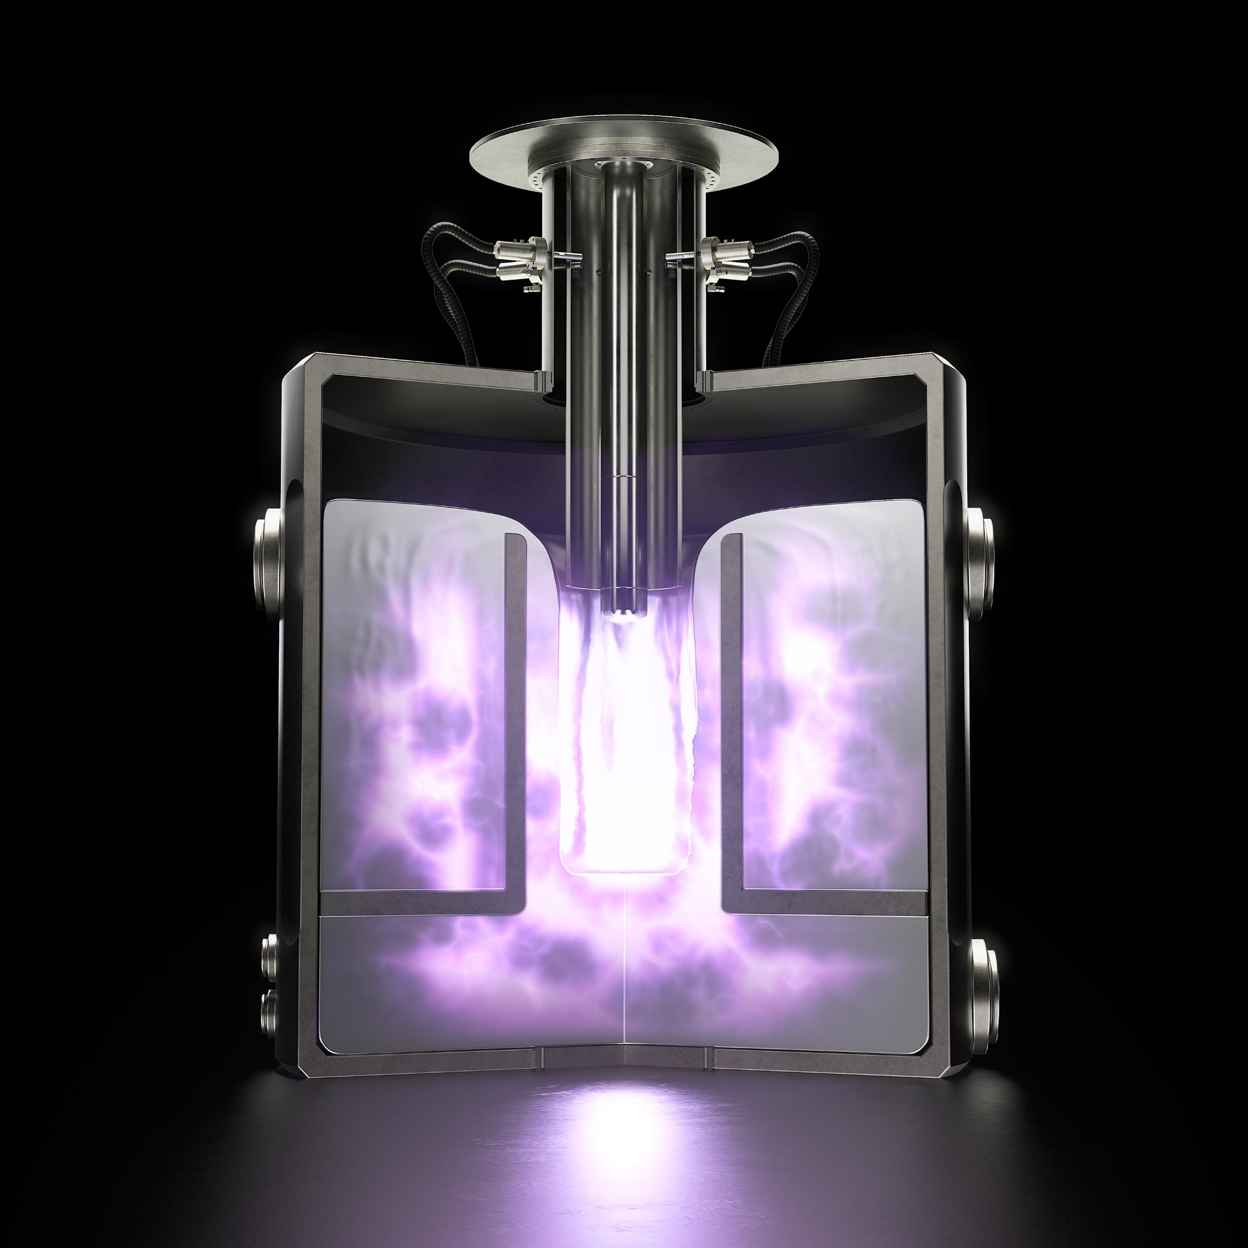
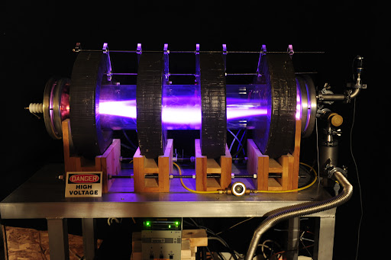
First Proposed MCF Techniques
Magnetic mirrors
Theta-pinches
Z-pinches

Slide 15
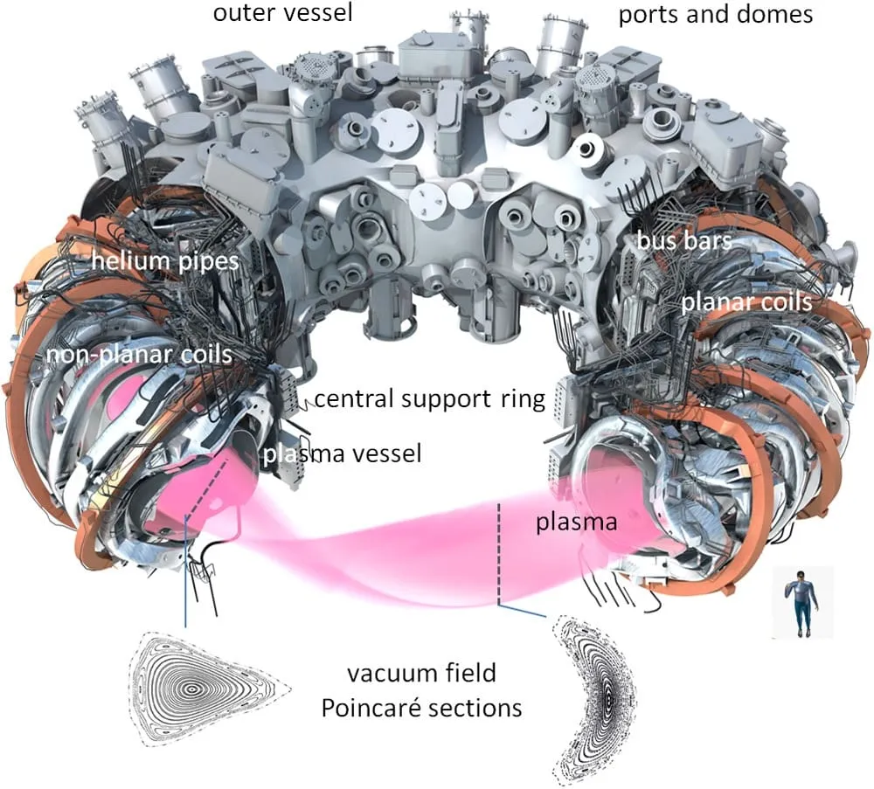
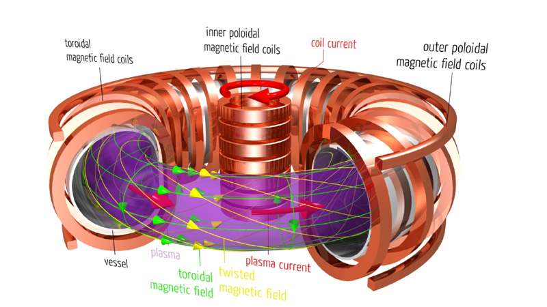
More Modern MCF Techniques
Tokamaks and stellarators

Slide 16
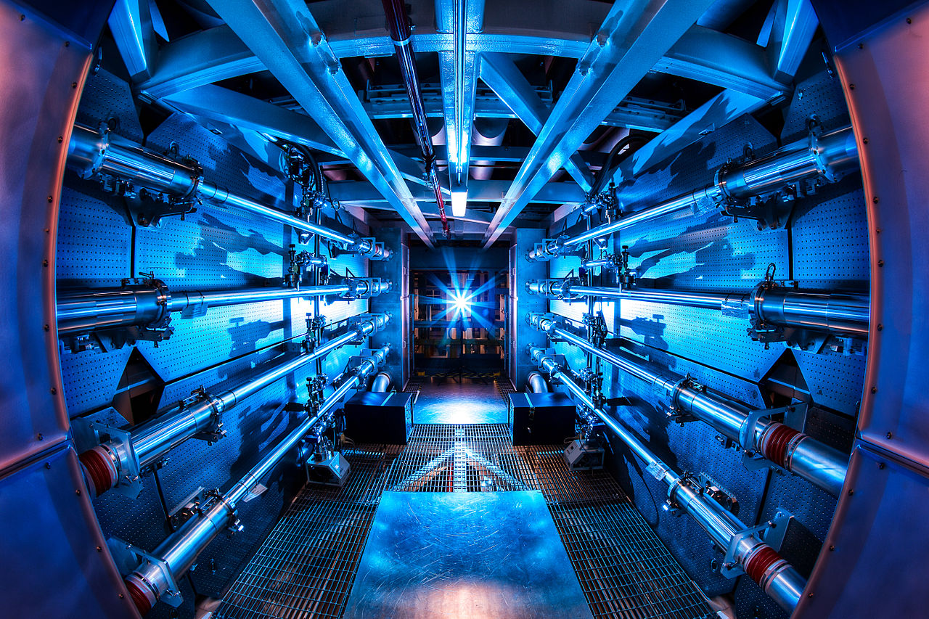
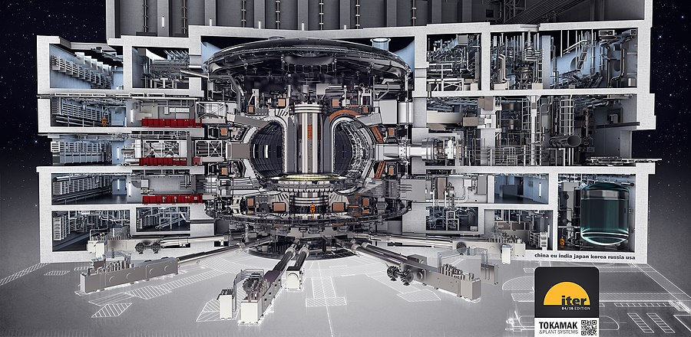
Recent Updates
NIF ICF breakthrough: net energy gain compared to laser output energy
ITER: international tokamak collaboration

Slide 17

Questions?

